Slide 1
Beliefs, Values and Attitudes
SYLLABUS POINTS:
Relationship between beliefs, attitudes, values and health behaviour
Influence of media, social networking, advertising and marketing on beliefs, attitudes and values

Slide 2
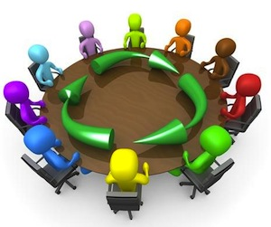
Class discussion
Tell the person opposite you what you think these terms mean:
Belief
Value
Attitude
This Photo by Unknown Author is licensed under CC BY-NC-ND

Slide 3
Beliefs
Definition: A person’s sense of right and wrong and assumptions made about things encountered in life or what is believed to be real and true.
They differ in intensity depending on the topic
Ie. We will often have stronger beliefs on topics that we place a high level of importance on
Here are some common beliefs that we might hold:
The earth is round?
Left-brained people are more logical and right-brained people are more creative?
Viruses spread faster in high density city areas?
Too much sugar will send a child into a crazy energy frenzy?

Slide 4
Class discussion
What are some commonly held beliefs regarding health behaviours that adolescent Australians might have?
Think: alcohol use, tobacco use, exercise, eating junk food, seeing a psychologist, tanning?
This Photo by Unknown Author is licensed under CC BY-NC-ND

Slide 5
Where do our beliefs come from?
Brainstorm!
Our parents, peers, the media, scientists, our culture, our own experiences?
SELF GENERATED | EXTERNALLY GENERATED
EXPERIENCE | EXPERTS
REFLECTION | AUTHORITY

Slide 6
SELF GENERATED
EXPERIENCE:
Based on a cause and effect relationship.
This is the STRONGEST way to form a belief and the belief is unlikely to be changed. (if you have experienced it yourself, it is very difficult for someone to change your mind)
E.g. Bill drinks too much alcohol. Bill feels disoriented, uncoordinated, relaxed and he has a big headache the following day. Bill experience has helped him to form a belief that too much alcohol creates these effects on his body.
REFLECTION
An individual internally reflects on experiences, observations, personal opinion and the viewpoints of others to generate their own beliefs.
Bill goes to a party. He has a couple of drinks. He watches as his friends exhibit some interesting behaviour. He draws on his education about alcohol from high school health class and forms the belief that alcohol can have a range of impacts on the body.

Slide 7
EXTERNALLY GENERATED
EXPERTS:
People tend to believe the experts advice or guidance as their knowledge in the area is trusted and respected.
Individuals believe studies and experiments that have been conducted by doctors or experts in the field that are supported by data and evidence and are therefore reliable and credible.
https://www.youtube.com/watch?v=3oM72442NOk
E.g. Bill watches a short video called “Alcohol and A-Fib” where a cardiologist explains the potential impact on the heart of what he calls “Holiday heart”
AUTHORITY:
People believe those that hold a perceived level of power (usually in a position of leadership) based on the title that they hold.
E.g. Bill’s parents explain to him that drinking alcohol affects the brain in a negative way. Bill forms a belief that alcohol is unhealthy because he respects his parents as they are authority figures in his life.

Slide 8
A controversial look at the media’s influence on beliefs…
The media portrays a range of external infleunces on our health behaviours. Consider celebrity role models, politicians, outspoken feminists, actresses and other people that present these views:
“Be a lady” Cynthia Nixon 2020
**Please be aware of media scenes: we are not endorsing any of these messages, but we will discuss the impact that these messages have on our beliefs, attitudes and ultimately, our health**
https://www.youtube.com/watch?v=EMl-8yrTnnE
These lines are fed to women on a regular basis.
How does this affect the way that women believe they should behave?
How does this affect how women believe they should look?
**This video is controversial because it highlights the inconsistencies in the messages that the media presents to women about their appearance, their behaviour and their identity.

Slide 9
Values
Definition: principles or standards of behaviour; one's judgement of what is important in life.
We all place differing levels of importance on things in our lives.
Values are not specific to an object or situation but are the moral standards that an individual uses to make decisions, determine ethical behaviour and standards of conduct.
Values can change depending on socioeconomic factors. (consider priorities)
Core values will usually be acquired from a young age, and they will provide a basis for the rest of our values.
Values are often based on culture, ethnicity, demographics and other factors such as peers.

Slide 10
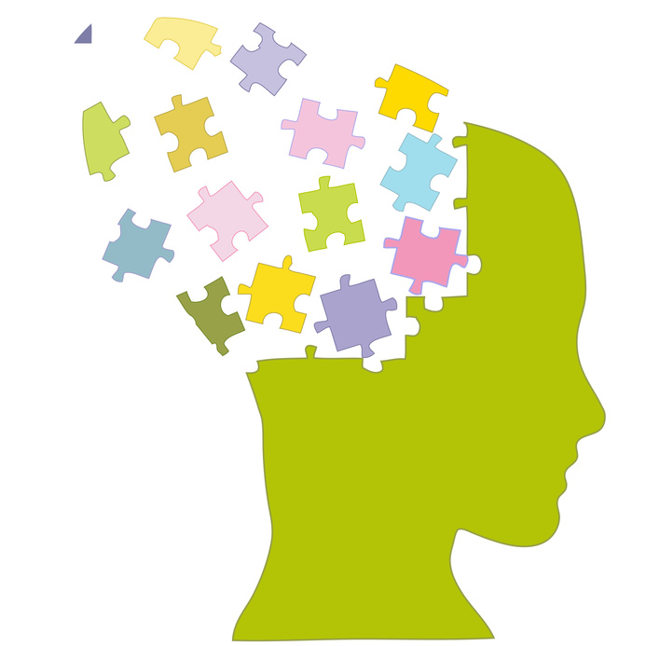
Class Brainstorm
What are some CORE VALUES?
This Photo by Unknown Author is licensed under CC BY-NC-ND

Slide 11
Values continued
We will tend to spend more time, money and effort on the people, objects and standards that we place a high level of importance on.
On the flip side, we will spend less time, money and effort on things that we don’t value as highly.
E.g. Jenny doesn’t value exercise. She doesn’t enjoy it, and she doesn’t feel that it improves her health. She is highly unlikely to purchase a gym membership, or buy clothes to work out in. She will rarely spend time doing exercise.

Slide 12
Attitudes
Definition: Positive or negative opinions or feelings that individuals attach to objects, people or situations.
Attitudes have 3 components:
Cognitive – thoughts and beliefs people hold
Affective – emotional feelings
Behavioural – predispositions to act in certain ways
A different perspective “The Power of Attitude” 4min video
https://www.youtube.com/watch?v=kVOr62MSZjU

Slide 13
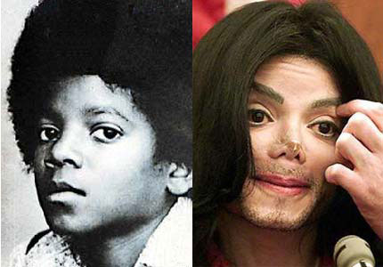

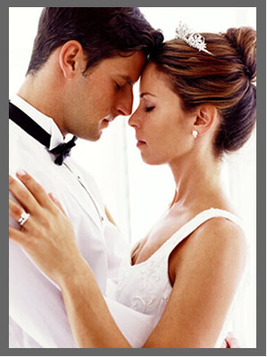
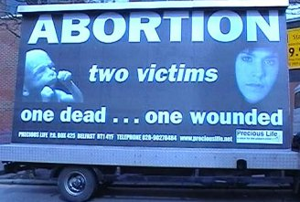


What are your attitudes about…

Slide 14
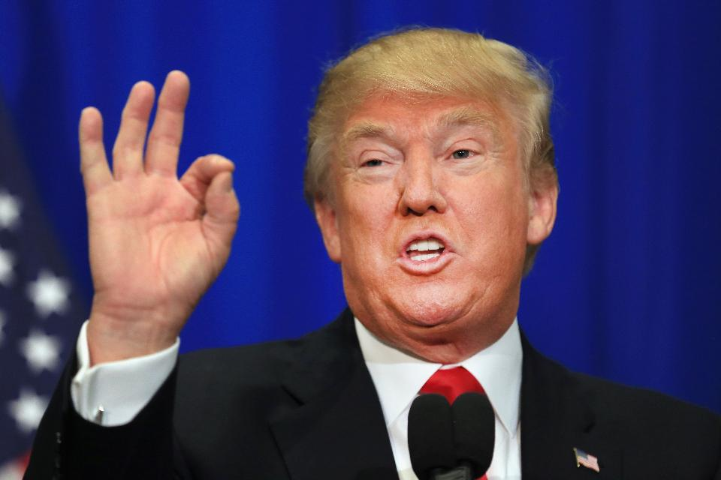

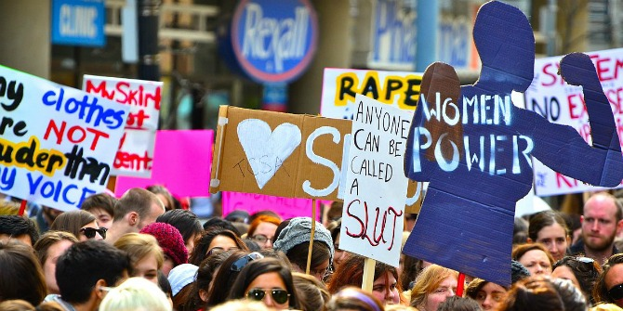
What are your attitudes about…
This Photo by Unknown Author is licensed under CC BY-SA
This Photo by Unknown Author is licensed under CC BY-NC

Slide 15

https://www.youtube.com/watch?v=2iRWCFetoxg “Behind the mac: International womens day”
What is your attitude towards…
Is your attitude towards APPLE influenced at all through this ad?
This Photo by Unknown Author is licensed under CC BY-SA

Slide 16
How do B, V, A’s impact behaviour?
 | Belief | Value | Attitude | Behaviour | Impact on Health
Plant based diet | Eating mostly a plant-based diet is best | Quality of life and longer life | Positive thoughts about eating a vege burger | Will make decisions about food based on meat avoidance. | Most likely better for health status. Decreased risk of CHD, diabetes, obesity etc.
Recreational drug use | Achieving pleasure in life is the most important factor. Belief that they will not be harmed. To fit in, drugs are a normal behaviour. | Feeling good and having pleasure. Social acceptance. | Positive towards anything that causes pleasure, and therefore positive towards recreational drug use | Is more likely to engage with recreational drug use and attend events that are likely to provide opportunities to obtain and use illegal drugs | Negative impact on health: cardiovascular issues, mental health issues such as hallucinations and psychosis, social issues, financial & legal implications
Annual skin checkup | Early detection reduces the chance of premature mortality. Screening is cheap and effective | Quality of life and longer life. Peace of mind | Positive towards getting skin checked regularly | Will book in regularly to get a skin check, and encourage others to aswell. | Positive impact on health. Early detection increases chance of effective treatment and improved QOL. Reduces stress and anxiety.

Slide 17
Class discussion
Firstly, what constitutes as “MEDIA?”
Secondly, How can the media have an influence on our beliefs, attitudes and values?
This Photo by Unknown Author is licensed under CC BY-NC-ND

Slide 18
How does the media impact Health?
The media works to create opportunities, incentives or reduce barriers which influences one’s ability to partake in healthy behaviours.
Opportunity
Media will use “limited opportunity” to create fast action (FOMO)
Incentives-
The media will advertise products by creating an expectation of certain outcomes. (even if they are unrealistic)
Barriers-
The media will also sell solutions to perceived barriers. These can be both positive or negative.

Slide 19
Positive media influences:
The media will aim to change beliefs by presenting new information, using values to their advantage and convincing the consumer that they need the product.
“Always #LikeAGirl” 3min video
https://www.youtube.com/watch?v=XjJQBjWYDTs&t=133s
What beliefs are being targeted in this advert?
What behavior does the producer of this advert want to adopt?
How have they targeted the beliefs of the target audience?
The media will try to change beliefs in order to influence peoples attitudes towards their product.
Messages delivered by the media imply that they represent societies values. Individuals will choose to, consciously or not, take on these values.
Reading
Text: Pages 68-71

Slide 20


Negative media influences:
How can media negatively influence our beliefs?
If the media portrays negative behaviours as “normal” and “expected” this can create unhealthy social norms.
Television show “Gossip Girl” portrays a range of negative behaviours including backstabbing, illegal drug use, unhealthy relationships, manipulation, gambling and eating disorders all associated with wealth and high social status.
The Victoria Secret model image have morphed over the years into an unattainable and unhealthy body type. These models are plastered over billboards and screens all over the world, to the point where this body shape is considered “normal”

Slide 21
Social Networks
We all exist in social networks.
Our ties to the other people in our networks are either one-way or two-way ties.
One-way: information flows from one person to another
Two-way: information flows back and forth between two people
When at how our social networks impact our beliefs, attitudes and values we need to examine:
Who we interact with
Who they interact with
THEREFORE A person's beliefs, attitudes and values may be influenced by someone they do not directly interact with.
Reading
Textbook page 72

Slide 22
Social Networks: Connectedness
People involved in highly connected networks will be more influenced than those with minimal connectedness.
Highly connected networks spread information faster and more widely.
Minimally connected networks spread information more slowly and less widely.
THEREFORE
If someone in a tightly connected network changes their beliefs about a certain topic, this change could spread through the network very quickly.

Slide 23
VIDEO
Nicholas Christakis
“The hidden influence of social networks”
https://www.youtube.com/watch?v=2U-tOghblfE

Slide 24
Question writing activity
You need to design a question for a future WACE exam to assess the students understanding of the influence of social networking on beliefs, attitudes and values
You need to create an example (a short case study) and assess both surface level understanding and deep level understanding. (ideally 5-10 marks)
Work in partners
Create your question on the word document page I sent you via direct message ☺
On the second word document page, you need to create a marking key!
Return it to me via direct message when you are finished.

Slide 25
The Health Belief Model
SYLLABUS POINTS:
Purpose and elements of the Health Belief Model
perceived susceptibility
perceived severity
perceived barriers
perceived benefits
cues to action
self-efficacy

Slide 26
Class discussion
If we consider ourselves to be completely healthy and at no risk (or very minimal risk) of illness or disease, would we be motivated to:
Seek medical help?
Be regularly screened/tested?
Be immunized?
This Photo by Unknown Author is licensed under CC BY-NC-ND

Slide 27
What is the Health Belief Model?
It is a framework created in the 1950s in response to a failed, free tuberculosis screening program…
Why did people not want to use this free service?
The Health Belief Model (HBM) examines attitudes and perceptions towards both the issue and the prevention strategy.
The HBM assumes that behaviour change occurs with the existence of three ideas at the same time
An individual recognizes that there is enough reason to make a health concern relevant (susceptibility and severity)
The person understands he or she may be vulnerable to a disease or a negative health outcome (perceived threat)
Individual must realise that behaviour change can be beneficial and will outweigh any costs

Slide 28
What is the Health Belief Model? Cont’d
HBM is a health promotion tool that aims to help us better understand and ultimately change behaviour for the better.
All preventative strategies require the individual to be MOTIVATED to participate in the strategy.
https://www.youtube.com/watch?v=6iVi5EmlewI
The HEALTH BELIEF MODEL helps us to understand the FACTORS that influence our motivation to participate in health preventative strategies.

Slide 29
Class Brainstorm
What are some Prevention Strategies?
This Photo by Unknown Author is licensed under CC BY-NC-ND

Slide 30
Let’s define something first…
What does the term “PERCEPTION” mean?
the ability to see, hear, or become aware of something through the senses.
The act of “Perceiving” is the ability to SENSE something, to analyse what is going on and make sense of it in their mind. People use their attitudes and beliefs to help them decipher messages and process what is going on.
Ie. Someone who is “perceptive” is very good at analysing and processing what is going on around them (usually unconsciously using their attitudes and beliefs)

Slide 31
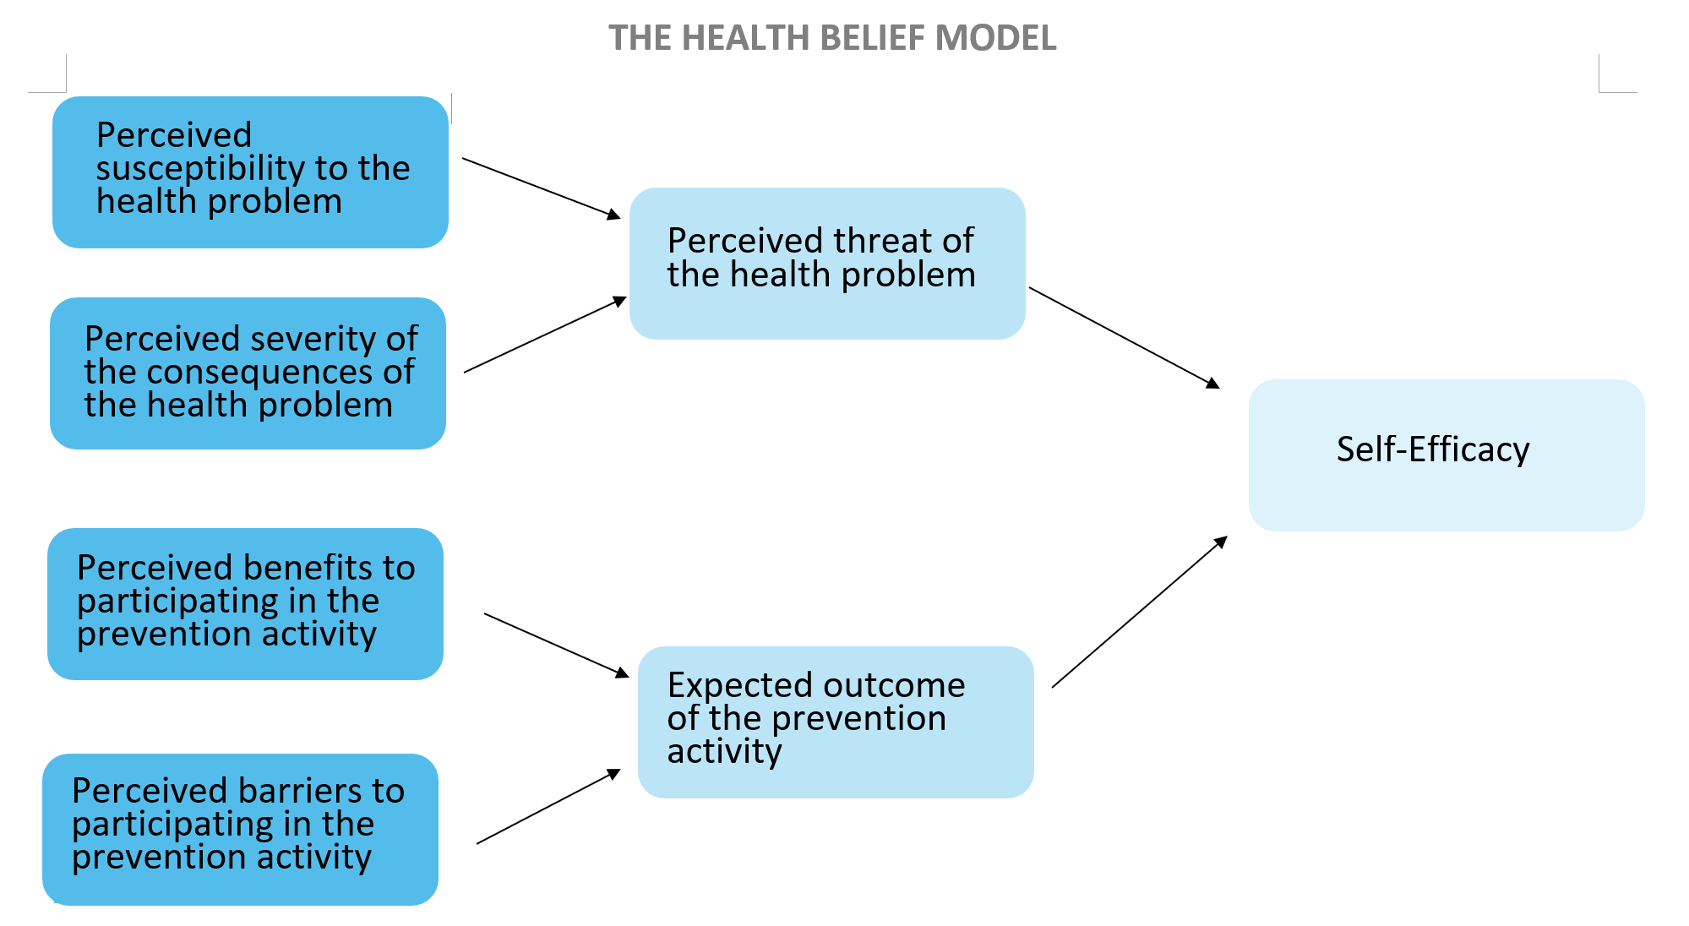
We are going to explore each element of the model individually

Slide 32

Perceived Susceptibility to the health problem
The risk a person feels that they have to a particular disease or health outcome.
E.g. How susceptible does Bill feel that he is to getting the flu? Does he get it every year? Does he have a compromised immune system? Is he in a high-risk demographic for the flu? Does he work a job that requires him to work with a lot of potentially infected people?

Slide 33
Perceived severity/seriousness of the consequences of the health problem
How serious are the potential consequences of the disease?
HBM:
*seeks to increase awareness of how serious the health outcomes of behaviours can be.
E.g. How serious are the health impacts of the flu for Bill? Is it just going to be a couple of days off work and a runny nose, or could the symptoms include hospitalization and a month off work? Or could he die from the flu?

Slide 34
Perceived threat
Does the individual believe that this health issue poses a large threat to their life/health status? Is it a concern?
Perceived threat includes the two elements:
Perceived Susceptibility to the health issue
Perceived Severity/Seriousness of the consequences of the health issue
E.g. Bill believes that he is susceptible to the flu because of his job and because he often gets sick. He knows the symptoms often stick around for weeks on end and make him unable to work and he feels miserable. He believes that the flu poses a high level of threat to his health.

Slide 35
Perceived benefits of the specific action
What are the BENEFITS of participating in the prevention strategy?
The individual must be convinced that the intervention is SAFE and will WORK.
E.g. Bill understands that getting the flu shot will significantly reduce his chance of getting the flu, and it will protect others by creating herd immunity.

Slide 36
Perceived barriers of the specific action
What are the reasons why the individual should not participate in the prevention strategy?
Eg. Bill might feel that engaging in this strategy will cost him a little money and time to go to the doctor.

Slide 37
Outcome Expectations
What is the individuals perception of the potential success of this prevention strategy?
Their expectations is based on their:
Perceived Benefits
Perceived Barriers
For change to happen, the individual must BELIEVE that the benefits outweigh the barriers.
E.g. Bill believes that the little time and money that is required for him to get the flu shot is worth it to be protected against the flu.

Slide 38
Self Efficacy
An individuals self belief that they can engage in the prevention strategy.
Outcome expectations and perceived threat can have an impact on ones perceived ability to participate in an intervention for their health.
E.g. Bill believes that he is at a high risk of getting the flu. He also believes that the flu shot is an achievable and effective way to prevent him from getting the flu. Therefore, Bill believes that he can go and get the flu shot. Good job, Bill.

Slide 39
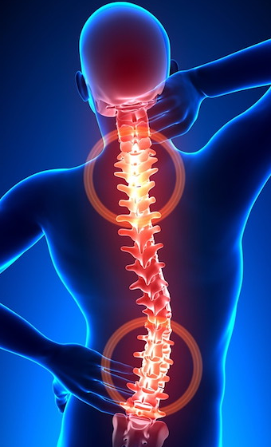
Cues to Action
Internal: pain, illness.
External: illness/pain of someone close to you, the media, product health warning labels etc.
Eg. Postcard reminder from the dentist for your checkup….Internal or external Cue to Action??
CUE INTENSITY: how intense the Cue is…varies between individuals (depending on perceived susceptibility, perceived barriers, perceived benefits etc)
This Photo by Unknown Author is licensed under CC BY

Slide 40
Health Belief Model Overview
https://www.youtube.com/watch?v=6SfTbTkEozA
(4 mins)

Slide 41
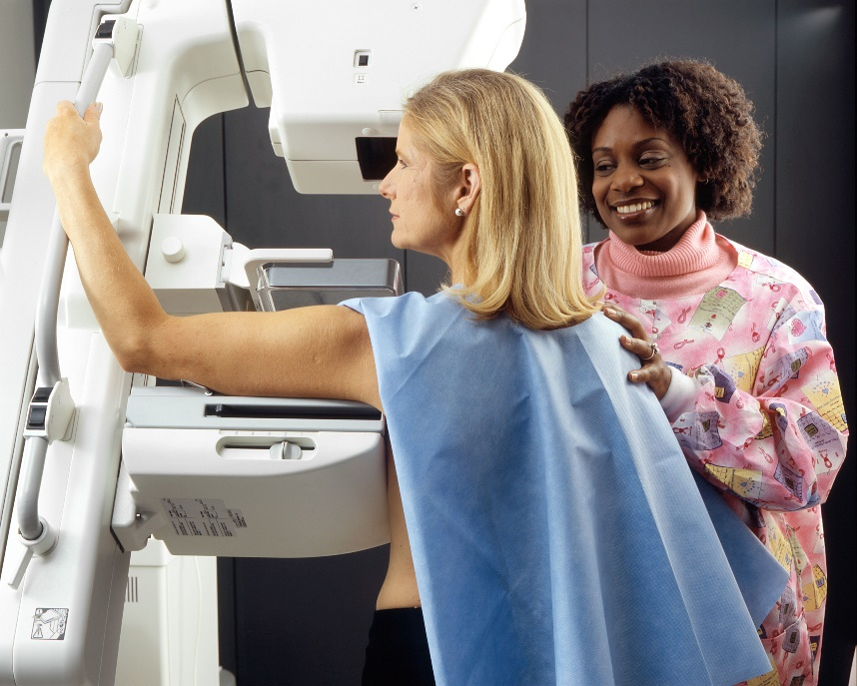
HBM Application Task
Apply the Health Belief Model to an individual who is considering utilizing Breast Cancer Screening services in Australia. Draw the Model and include MINIMUM 2-3 points for each heading.
This Photo by Unknown Author is licensed under CC BY-SA

Slide 42
Sources
Lockhart, E. (2010). Health Studies Stage 2A-b. Madeley: Print Publishing.
Image From: http://www.ohprs.ca/hp101/mod4/module4c3.htm

Slide 43
Self Management Skills #1
SYLLABUS POINTS:
Coping Skills and Strategies
Stress management
Accessing support
Time management

Slide 44
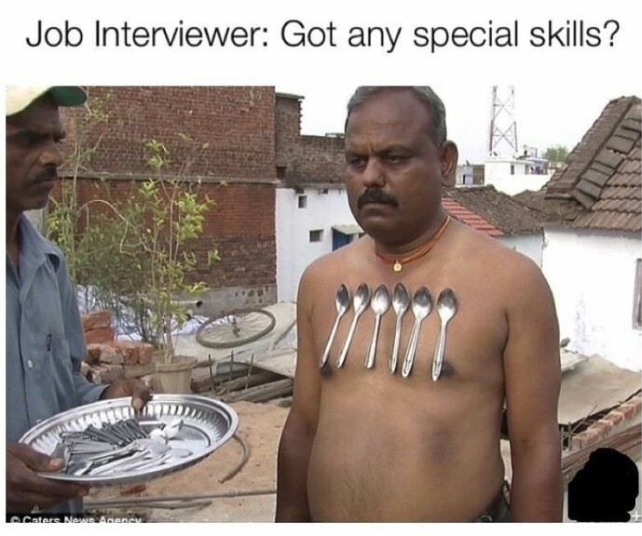
Skills vs Strategies
What is a SKILL?
The ability to do something well.
What is a strategy?
A plan of action to achieve a major overall aim. (planning and directing actions or movements)

Slide 45
Coping Skills
There are 3 key coping skills that we will cover:
COPING: the ability of an individual to deal effectively with a difficult situation.
Stress Management
“A range of techniques used to control a person’s level of stress and reduce the physical and emotional burden caused.”
Time Management
“Effectively planning use of time to balance commitments and relaxation times. The ability to be organised and plan ahead of time to reduce stress and maintain calm.”
Accessing Support
“The ability to ask for help and successfully utilise services and/or people to gain assistance”.

Slide 46
Stress
Firstly, what is stress??? (think back to the determinants of health)
https://www.youtube.com/watch?v=8sobA6G00tI
At the most basic level, stress is our body’s biological response to pressures from a situation or life event.
It can also be defined as the degree to which you feel overwhelmed or unable to cope as a result of pressures that are unmanageable.
Lets have a read!!!! Page 86 TEXTBOOK
It is important to note that stress incorporates several body systems
The goal of stress management is to create “coping behaviours” that help individuals to manage their stress effectively.

Slide 47
Class discussion
Discuss the keys things that cause high school students to feel anxious/worried/tense?
What strategies do you use to help deal with these things?
Discuss how these stressors change across the life span.
This Photo by Unknown Author is licensed under CC BY-NC-ND

Slide 48
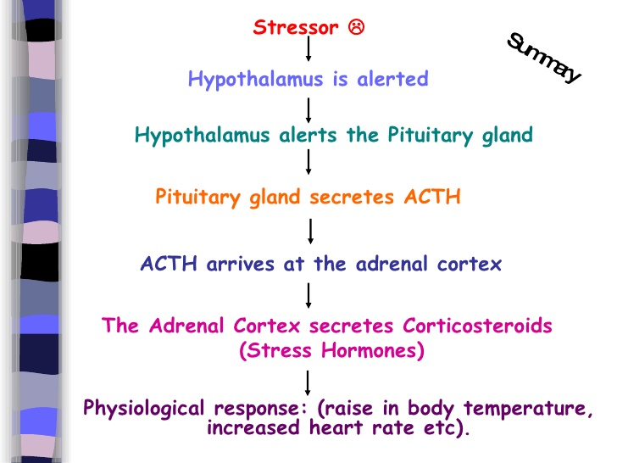
Stress continued
How stress affects your body - Sharon Horesh Bergquist
https://www.youtube.com/watch?v=v-t1Z5-oPtU 5 mins

Slide 49
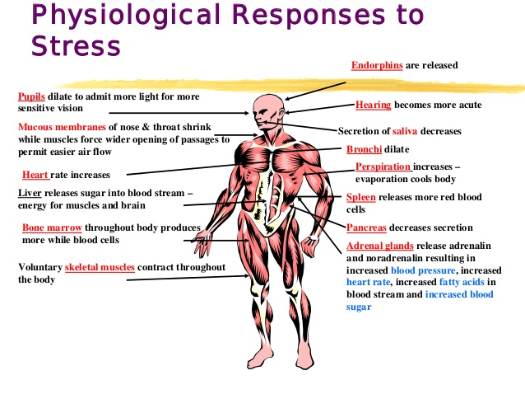
Stress continued

Slide 50
Let’s talk about stressors:
Can be either real or imagined
Environmental events
“set the stage” for the stress response to “kick in”.
Don’t cause the stress response
Ie. The same stressor/stimuli might cause one individual’s stress response to “kick in” and in another individual it won’t.

Slide 51
How can we make stress helpful?
Kelly McGonigal TED TALK
“How to make stress your friend”
https://www.ted.com/talks/kelly_mcgonigal_how_to_make_stress_your_friend?language=en

Slide 52
How can thoughts and emotions impact stress?
Thoughts & Emotions impact how the stressor is PERCEIVED.
Highly individual to each person
How a person perceives an event determines if it becomes a stressor or not.
Eg: a school swimming carnival can be a huge stressor for one student (swimming ability, wearing bathers in front of their peers etc) and for another student it barely gets a second thought and they LOVE it.
The perception of stressors can also vary within an individual: IT’S DYNAMIC
As time goes on, situations that once caused the stress response may no longer elicit the same response.
EXAMPLE? Todd Sampson-BODY HACK (Underwater) TV4 Education

Slide 53
Let’s get onto stress MANAGEMENT:
Strategies
People use a range of STRATEGIES to set up a plan to deal effectively with their stress.
Identifying stressors and planning to avoid or reduce them if possible
Building a support network of people who can be called upon when needed
Identifying coping behaviours that reduce the impact of stress
Planning in relaxation and leisure activities into your weekly/monthly diary.
Skills
BUT they must also possess SKILLS to actually carry out their stress management plan.
These skills include but are not limited to:
Being assertive and expressing their needs
Having the ability and self discipline to say no
Being reflective and learning from their mistakes
Effective communication skills

Slide 54
Stress Management Ideas
You will often be asked to identify “ways” to reduce or better manage stress. It is helpful to have a range of ideas ready to apply to your given situation
Engage in relaxation behaviours such as Smiling Minds guided meditations.
Practice mindfulness in activities such as colouring in
Create to-do lists with appropriate time frames
Use a diary/calendar/planner to organize your activities

Slide 55
Time Management
Definition: the ability to use one's time effectively or productively, especially at work.
If an individual manages their time well, they are able to reduce/avoid stress. (it is linked to stress management!)
HOW??
Come and write on the board ways that YOU manage YOUR time effectively.

Slide 56
Time Management skills and strategies:
Strategies
People use a range of STRATEGIES to set up a plan to deal effectively with their stress.
Planning ahead and creating appropriate time frames
Prioritizing activities and completing activities that are of a high importance before spending time on lower priority activities
Creating a plan for work/life/school balance
lifestyle plan to allow time for activities such as exercise, cooking, cleaning and socialising
Delegation of tasks to others so you don’t run out of time to complete them
Skills
BUT they must also possess SKILLS to actually carry out their time management plan.
These skills include but are not limited to:
Being able to tell the time
Being able to demonstrate self discipline and stick to assigned time frames
Having a realistic understanding of how long certain tasks take you to complete (accurate self assessment)

Slide 57
Accessing Support:
Definition: An individual's ability to find and utilize the support services and people around them.
An individual's ability to access support is determined by more than just knowing that the support is there.
There are 5 A’s to consider:
Affordability- Can you afford to pay for the service?
Availability- Are the people you need available to help when you need them?
Accessibility-geographical: can you get there?
Accommodation-can the support service accommodate you and your needs? Flexibility? Understanding?
Acceptability-is the support system “personally” acceptable to you? Do you trust them? What are their personal characteristics like?

Slide 58
Accessing Support skills and strategies:
Strategies
People can use STRATEGIES to set up a plan to access support
Setting up a plan for utilizing support systems (progression and varied opinions)
They must also possess SKILLS to access support
These skills include but are not limited to:
Ability to make phone calls and book appointments
Ability to discern between services and choose the one that is most appropriate for their needs

Slide 59
Accessing Support example:
If you are feeling overwhelmed and over stressed with your workload at Kennedy, what support systems are available within the College to help support you?
Head of year
Form teacher and subject teachers
Counsellor/school psychologist
RASC
Direct Message functions of Seqta

Slide 60
Revision Question:
Define and describe how skills and strategies are important for self management skills/stress reduction? (4 marks)
Explain 4 techniques for effective stress management (8 marks)

Slide 61
SEMESTER 1 EXAM PREPARATION

Slide 62
Self Management Skills #2
SYLLABUS POINTS:
Skills required for working effectively with individuals and groups
Negotiation
Conflict resolution
Mediation
Leadership

Slide 63

Class Task
Complete the tent activity as a group.
This Photo by Unknown Author is licensed under CC BY

Slide 64
Groupwork:
What skills worked when completing the tent activity?
Why Perspective is so important YOUTUBE (3 mins)
https://www.youtube.com/watch?v=cRcDfCafSYE
In groupwork, we have to account for a range of perspectives, opinions and ways of doing things. This can create tension and disagreements.
The skills that we are looking at work together to increase productivity in group work.

Slide 65
Groupwork skills: Conflict Resolution
Firstly, what is conflict?
Conflict is a clash of interests/opinions
Conflict resolution is the process by which two or more parties engaged in a disagreement, dispute, or debate reach an agreement resolving it.
When conflict is resolved effectively:
Increased awareness/understanding of other group members
Increased group cohesion
Stronger mutual respect
Improved self awareness
Effective conflict resolution involves skills such as:
EMPATHY, ASSERTIVENESS, MANAGING EMOTIONS, MEDIATION & NEGOTIATION.

Slide 66
Groupwork skills: Conflict Resolution
What does conflict resolution actually look like?
The steps of conflict resolution are:
IDENTIFY the problem. (why does the conflict arise?)
LOOK BEYOND the incident-what emotions are making this problem worse?
BRAINSTORM solutions. (consider all parties and their needs/interests)
CHOOSE a solution that works for everyone! (there may be some compromise required)
PLAN for the future so this conflict doesn’t happen again.
It’s important in conflict resolution to REMOVE the CONFLICT from the PEOPLE.
People can still love and respect each other while working through a conflict. (it shouldn’t become personal)

Slide 67
Groupwork skills: Mediation
MEDIATION is the process of negotiation to resolve differences that is conducted by some impartial party. The intervention is to bring about settlement and resolve conflict.
A MEDIATOR assists the two parties to create their own solution to resolve the conflict. Skills required include
Communication
Help determine facts and agendas
Show impartiality and empathy
Use persuasion to help parties see the issue from the other perspective.

Slide 68
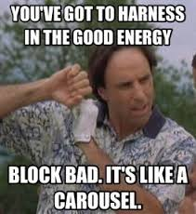
Groupwork skills: Mediation
Maintain a positive attitude.
-set a positive tone for communication
Refocus the negative.
-change the topic when negative emotions overpower the discussion
Create a common enemy.
-parties with a common enemy are more likely to unite together.

Slide 69
Groupwork skills: Negotiation
Negotiation is the process of achieving agreement through discussion, used to resolve disputes. Negotiators bargain for individual or collective advantage.
Negotiation is about UNDERSTANDING and ENGAGING with people more effectively.
Through negotiation, they can come to a resolve in a safe and cooperative way.
People restore their relationship post-conflict, but there may still be issues to be discussed/sorted out.

Slide 70
Groupwork skills: Negotiation
The stages of negotiation include: of Negotiation…
1. Preparation
Write out facts/opinions prior to the discussion
2. Discussion
Meet and discuss, both parties present their P.O.V
3. Clarification of goals
Rehash the main goal/priority of the discussion
4. Negotiate Outcome
Discuss options/outcomes/compromises.
Ensure everyone feels heard and understood
5. Agreement
Plan for the future, together select a solution to move forward
6. Implementation
Give it a go! Put the plan into action and review it early.

Slide 71

Negotiation example
2014 saw the tenth anniversary of the landmark Argyle Participation Agreement between Rio Tinto and the traditional owners of the mine, the Gija and Mirriuwung people.
When the Participation Agreement was signed a decade ago, it set a new benchmark in Australia for land use agreements between resource companies and traditional owners: it created not only income streams for future generations of local Aboriginal people, but also significant training, employment and business development opportunities and a voice for Aboriginal people in mining decisions affecting their interests.
For example, during the negotiation of the Agreement, Argyle provided an undertaking that was probably unique in the history of the mining industry: Argyle would not proceed with its plans for an underground mine without the approval of the traditional owners, despite the fact that this was not required by law.
This Photo by Unknown Author is licensed under CC BY-SA

Slide 72
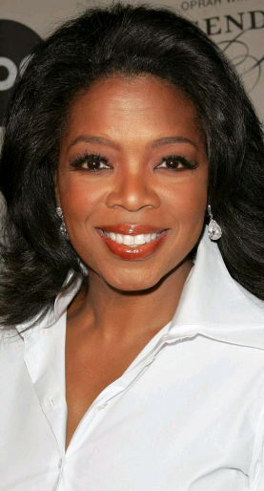
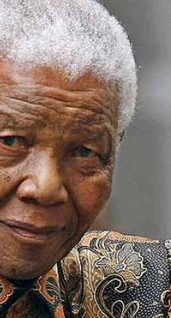
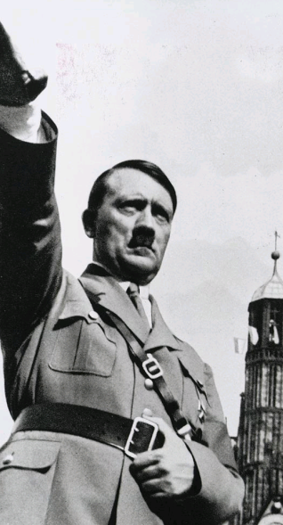
Groupwork skills: Leadership
LEADER: a person who guides, inspires & directs others.
What does a good leader look like?

Slide 73
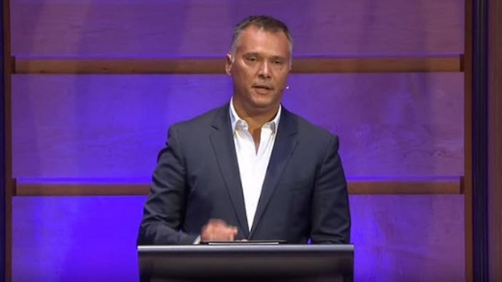
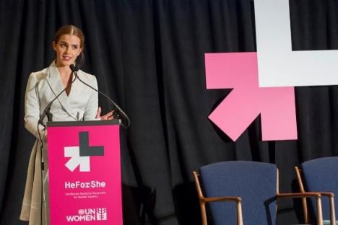
Groupwork skills: Leadership
IQ2 Racism Debate
Stan Grant- Professor of Global Affairs at Griffith University https://www.youtube.com/watch?time_continue=21&v=uEOssW1rw0I&feature=emb_logo –8:34
Addressing the UN to advocate for womens rights
Emma Watson https://www.youtube.com/watch?v=gkjW9PZBRfk -13:15
This Photo by Unknown Author is licensed under CC BY-SA-NC
This Photo by Unknown Author is licensed under CC BY-NC-ND

Slide 74
Groupwork skills: Leadership
A good leader…
enlists help and support from others to achieve a common goal or task.
Can influence group members beliefs, attitudes through their interaction
Inspires others to become a “better version of themselves”
Set the direction of the group.
Do the previous videos demonstrate good leadership?
There are different ways to lead effectively…
Autocratic
Democratic
Laissez faire

Slide 75
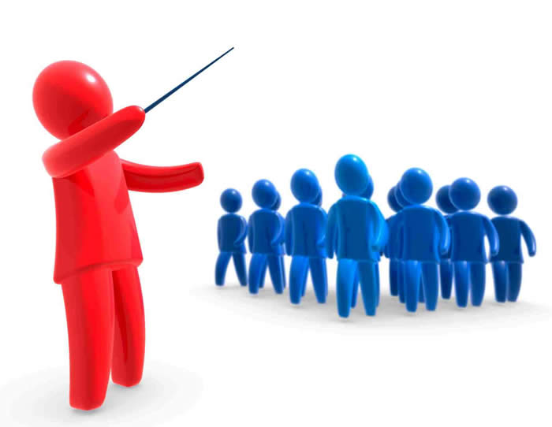
Leadership: Autocratic
https://www.youtube.com/watch?v=U6SM057qEy4
Coach Carter Workout scene (2 min)
What are the key characteristics of autocratic leadership?
Makes decisions without consulting others
Clear distinction between leaders and group members
What are the advantages of autocratic leadership?
Chain of command is clear and well understood by all
Decision making is fast and organized (streamlined)
Maintains order and discipline
What are the disadvantages of autocratic leadership?
Generally have the highest level of discontent amongst group members
Group members are often unmotivated
When is autocratic leadership most effective?
emergency and crisis situations
When group members have a low skill level
This Photo by Unknown Author is licensed under CC BY

Slide 76
Leadership: Democratic
DEMOCRATIC - https://www.youtube.com/watch?v=Pcx6HLPtVZ0 “collaborative”
What are the key characteristics of democratic leadership?
The leader consults others before they make decisions
What are the advantages of democratic leadership?
Generally group members feel appreciated and heard (empowered)
Increases the options and ideas as group members can express their opinions
What are the disadvantages of democratic leadership?
Decision making often takes a long time
“mob mentality” can impact others if there is a dominant faction within the group
When is democratic leadership most effective?
Situations that have time, and require creativity

Slide 77
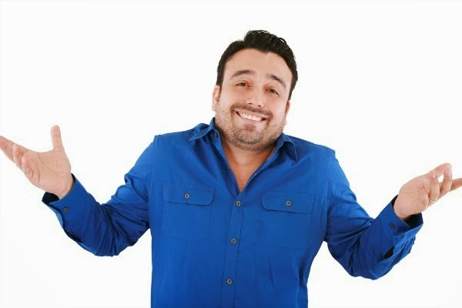
Leadership: Laissez Faire
LAISSEZ-FAIRE (French: Non Interference)
https://www.youtube.com/watch?v=cRC7ZFiLHmA
What are the key characteristics of laissez faire leadership?
Minimal input by the leader, allows people to make their own decisions
Often called “casual” leadership
Group members are expected to solve problems themselves
What are the advantages of laissez faire leadership?
Group members can set their own goals
What are the disadvantages of laissez faire leadership?
Can lead to disunity amongst group members
Often the group lacks direction and purpose therefore reduces productivity
When is laissez faire leadership most effective?
When the group members are competent, independent & self motivated
In tasks that require creativity and research
This Photo by Unknown Author is licensed under CC BY-SA

Slide 78
Personality Styles & Communication
SYLLABUS POINTS:
Influence of introvert and extrovert personality styles on communication

Slide 79
Personality Styles
https://www.youtube.com/watch?v=PWIp2GTZwCQ
Introverts vs Extroverts: What’s the difference? Ft Anthony Padilla (4 mins)
Dr Debra Johnson’s experiment (1989)
Studied the blood flow in the brain
INTROVERTS: more blood flow in memory/analysing/planning and problem solving
EXTROVERTS: more blood flow as a result of sights/sounds/touch and taste.
Let’s take a look at the key characteristics of each personality style

Slide 80
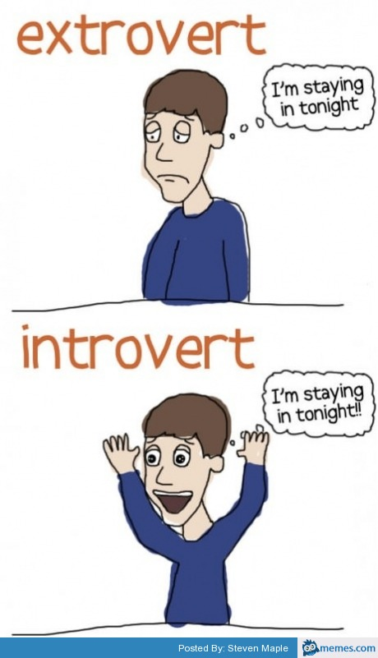
Personality Styles: Extroverts
What are the key characteristics of extroverts?
People who get their energy from other people and the world around them
Gregarious
Assertive
Talkative
Social/outgoing
Likes groups, parties, etc.
Expressive & enthusiastic
Volunteers personal information
Easy to approach
This Photo by Unknown Author is licensed under CC BY-NC-ND

Slide 81

Personality Styles: Introverts
What are the key characteristics of introverts?
People who get their energy from within themselves
Need quiet to concentrate
Are reflective
Take time making decisions
Feel comfortable being alone
Don't like group work
Feel tired after being in a crowd
Have fewer friendships, but are very close
with these friends
This Photo by Unknown Author is licensed under CC BY-NC-ND
Personality test: Are you an extrovert or introvert?
https://www.16personalities.com/free-personality-test

Slide 82
Personality Styles & Communication
How does personality style impact communication?
People who have significantly different personality styles often have trouble communicating with each other. Why?
They do things differently! They often view situations differently and therefore approach situations differently and ultimately behave differently.
This can cause conflict when people think that a different approach/ behaviour is wrong because it is not the same as their own.

Slide 83
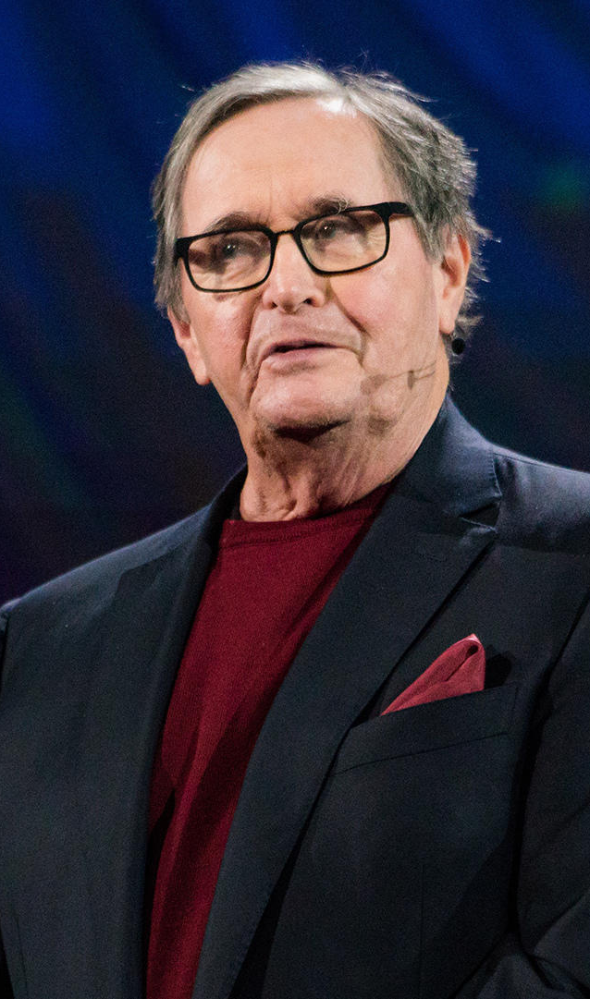
Labels are good but they are not everything.
https://www.youtube.com/watch?v=qYvXk_bqlBk&t=550s
15:16 mins

Slide 84
Apply!
Why might an introvert find it difficult to communicate within the Australian culture? Explain why.
Describe the personality attributes of an extrovert and give 3 reasons why they might struggle to get along with an introvert.
Jump on the internet. Find 2 examples of leaders who fit into each leadership style. (Autocratic, Democratic and Laissez-Faire)

Slide 85
Sources
http://www.islamicity.com/global/images/photo/IC-Articles/Heart-Love-Sky-Hands-Silhouette__1920x1200.JPG
http://img.thesun.co.uk/aidemitlum/archive/01652/SNF1134HIT--_1652387a.jpg
http://www.daviddibble.com/media/2011/02/Oprah_Winfrey_Biography.jpg
http://cdn1.theodysseyonline.com/files/2015/03/28/635631062252597205103151809_introvert-mind.jpg
Lockhart, E. (2010). Health Studies Stage 2A-b. Madeley: Print Publishing.
http://www.slideshare.net/ghaiath/stress-main-presentation-pdf

Slide 86
Health Literacy
SYLLABUS POINTS:
Definition of, and skills required for, health literacy
Accessing, reading and comprehending health information
Engaging in self care and disease management

Slide 87
What is Health Literacy?
https://www.youtube.com/watch?v=JXvGToFbZb4
What is Health Literacy (6 mins)
Health Literacy
“The ability of individuals to access and understand health information and to use this information to make informed, wise decisions.”

Slide 88
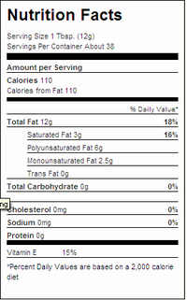
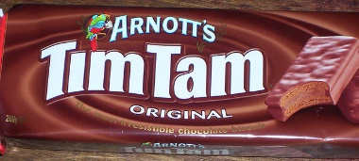
Health Literacy Levels
Level 1: Functional Health Literacy
A person will be at this level of health literacy if they are able to choose products and services for personal use, understand instructions on labels, and have some knowledge of risks.
This Photo by Unknown Author is licensed under CC BY-SA-NC
This Photo by Unknown Author is licensed under CC BY-NC-ND

Slide 89
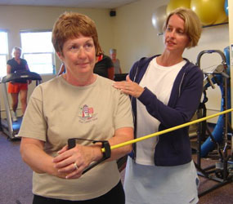
Health Literacy Levels
Level 2: Interactive Health Literacy
At this level individuals will seek to improve their own personal skills and strategies to act on health advice.
This Photo by Unknown Author is licensed under CC BY-SA

Slide 90
Health Literacy Levels
Level 3: Critical Health Literacy
The awareness of the relationship between language and power. People can look at health information with discernment and judgment in order to ensure that they are not manipulated by the media to act in certain ways.
At this level, people will have the cognition and skills to “initiate social and political action for health outcomes”. These people use their understanding of social, environmental and economic determinants of health to seek change for the good of the community.

Slide 91
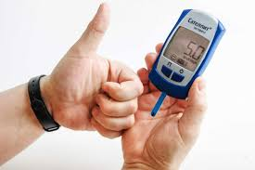
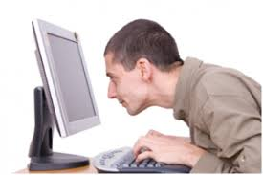
Skills for Health Literacy
Access health information
Read health information
Comprehend health information
Engage in self-care
Engage in disease management.

Slide 92
Skills for Health Literacy: Accessing
Accessing* refers to being able to obtain or retrieve the information you need.
Accessing includes:
Locating information (internet, library, books. Health centres)
Selecting the appropriate information
Considering the validity and reliability of the information (author credibility)
Having the right to own/read the information (some journal articles are not open to the public)
The individual must also be able to have the rights to access information about their health (e.g. their own health records or blood test results)
E.g. Google searching “should I get the flu jab” will likely bring up different pages than “risks associated with influenza vaccine”

Slide 93
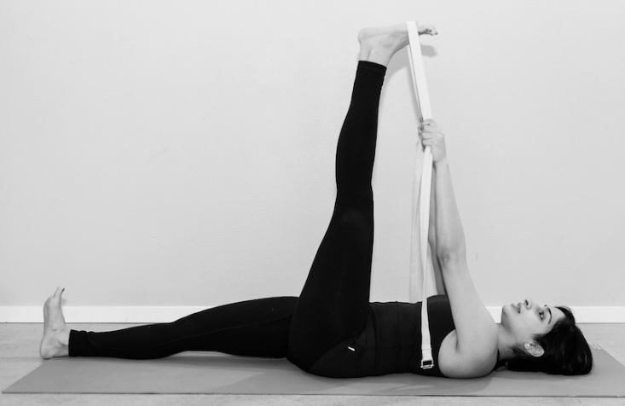
Skills for Health Literacy: Reading
A person needs to be able to read health information that they have access to.
Reading includes:
The information being available in the right language
The individual’s reading level must be able to read the jargon and health terminology
Often health information presented by doctors/health professionals is written at a level much too sophisticated for the patients reading level.
Example?
Physio “Just do some proprioceptive
neuromuscular facilitation three
times a week for 2 weeks”
This Photo by Unknown Author is licensed under CC BY-NC-ND

Slide 94
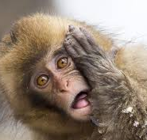
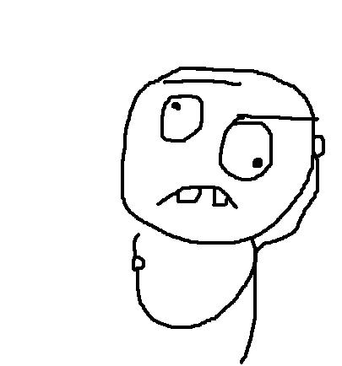
Skills for Health Literacy: Comprehending
Comprehending means “to grasp the content” or “to understand”
People must be able to put their health advice into practice.
Who has left the doctor before feeling confused?
Comprehending includes:
Able to put into practice the things you have read (application of information to a unique situation)
E.g. understanding that if you are an adult the dosage of a given medicine is different than a child, and therefore taking the correct dose.
This Photo by Unknown Author is licensed under CC BY-SA

Slide 95
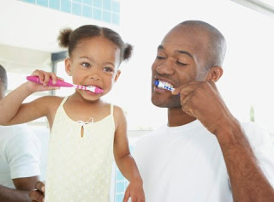
Skills for Health Literacy: Self Care
What is self care?
Self care includes the actions that people take for themselves, their children and their families to stay healthy and well.
Self care includes all aspects of health:
Eating healthy, nutritious diet
Undergoing rehabilitation activities
(like stretching and strengthening activities)
Relaxation activities
(yoga, meditation, mindfulness, massage)
Taking medication
Hygiene activities
(brushing teeth, showering, general personal maintenance)
Self screening (self examination for skin and breast health)
Sleep!
This Photo by Unknown Author is licensed under CC BY-ND

Slide 96
Another perspective on self care…
“Self-care is often a very unbeautiful thing.
It is making a spreadsheet of your debt and enforcing a morning routine and cooking yourself healthy meals and no longer just running from your problems and calling the distraction a solution.
It is often doing the ugliest thing that you have to do, like swear through another workout or tell a toxic friend you don’t want to see them anymore or get a second job so you can have a savings account or figure out a way to accept yourself so that you’re not constantly exhausted from trying to be everything, all the time and then needed to take deliberate, mandated break from living to do basic things like drop some oil into a bath and read Marie Claire and turn your phone off for the day.
A world in which self-care has to be such a trendy topic is a world that is sick. Self-care should not be something we resort to because we are so absolutely exhausted that we need some reprieve from our own relentless internal pressure.
True self-care is not salt baths and chocolate cake, it is making the choice to build a life you don’t need to regularly escape from. And that often takes doing the thing you least want to do.
It often means looking your failures and disappointments square in the eye and re-strategizing. It is not satiating your immediate desires, It is letting go. It is choosing new, It is disappointing some people. It is making sacrifices for others. It is living a way that other people wont’ so maybe you can live in a way that other people can’t...

Slide 97
Another perspective on self care…
…It is letting yourself be normal. Regular. Unexceptional. It is sometimes having a dirty kitchen and deciding your ultimate goal in life isn’t going to be having abs and keeping up with your fake friends. It is deciding how much of your anxiety comes from not actualizing your latent potential, and how much comes from the way you were being trained to think before you even knew what was happening.
If you find yourself having to regularly indulge in consumer self-care, it’s because you are disconnected from actual self-care, which has very little to do with ‘treating yourself’ and a whole lot to do with parenting yourself and making long-term choices for your long-term wellness.
It is no longer using your hectic and unreasonable life as justification for self-sabotage in the form of liquor and procrastination. It is learning how to stop trying to ‘fix yourself’ and start trying to take care of yourself…and maybe finding that taking care lovingly attends to a lot of the problems you were trying to fix in the first place.
It means being the hero of your life, not the victim. It means rewiring what you have until your everyday life isn’t something you need therapy to recover from. It is no longer choosing a life that looks food over a life that feels good. It is giving the hell up on some goals so you can care about others It is being honest ever if that means you aren’t universally liked. It is meeting your own needs so you aren’t anxious and dependent on other people.
It is becoming the person you know you want and are meant to be, Someone who knows that salt baths and chocolate are ways to enjoy life, not escape from it.”
-Brianna Wiest

Slide 98
Skills for Health Literacy: Disease Management
Disease management is an approach to healthcare that teaches patients how to manage a chronic disease including learning to take responsibility for understanding how to take care of themselves, avoid potential problems or worsening their condition.
What is a chronic disease?
“Illness that is prolonged in duration, does not usually go away by itself, and is rarely cured completely”. Some examples include Cancers, cardiovascular disease, respiratory disease and diabetes.
The patient will learn to take responsibility of understanding how to care for themselves and their ailment. This will allow them to avoid potential problems, or worsening of the current problem.
Goal: Promote self management of all patients, and to help the individual work with health professionals to manage their condition.
Outcome: Less reliant on health professionals, spend less time in hospital, patients are encouraged to learn disease management principles.
This Photo by Unknown Author is licensed under CC BY-NC-ND

Slide 99
Disease Management Principles
1. Care Planning
Patients work with health professionals to develop a detailed disease management plan. Will consist of types of care needed, and guidelines for monitoring, check ups and medication.
2. Self-Monitoring
Patients are taught the symptoms of their condition, and how to monitor themselves for signs and symptoms.
3. Self-Administered Treatment
Once patients can self-monitor, they can be taught to administer their own medication/treatment.
4. Allied Health Professionals
The patient will remain in contact with professionals such as nutritionists, physio’s and psychologists to support their management of the disease.
5. Emergency Contact
It is encouraged for patients to have contact details of their GP, specialist and pharmacist. This allows them to be independent whilst having the ability to get emergency help when needed.
6. Review
Regular appointments with a health care professional to monitor their progress, adjust treatment plans and refer for specialised monitoring (e.g. x-ray/blood tests/ultrasound).

Slide 100
Health Literacy report
WHO 2009 report on Health literacy
See highlighted sections that has directly linked content
Other areas will be very useful for further understanding
Please read – See Seqta under Health Literacy lessons for document

Slide 101
Sources
Lockhart, E. (2010). Health Studies Stage 2A-b. Madeley: Print Publishing.
World Health Organisation, 2009 Health Literacy And Health Promotion - World Health Organization

